Slide 1
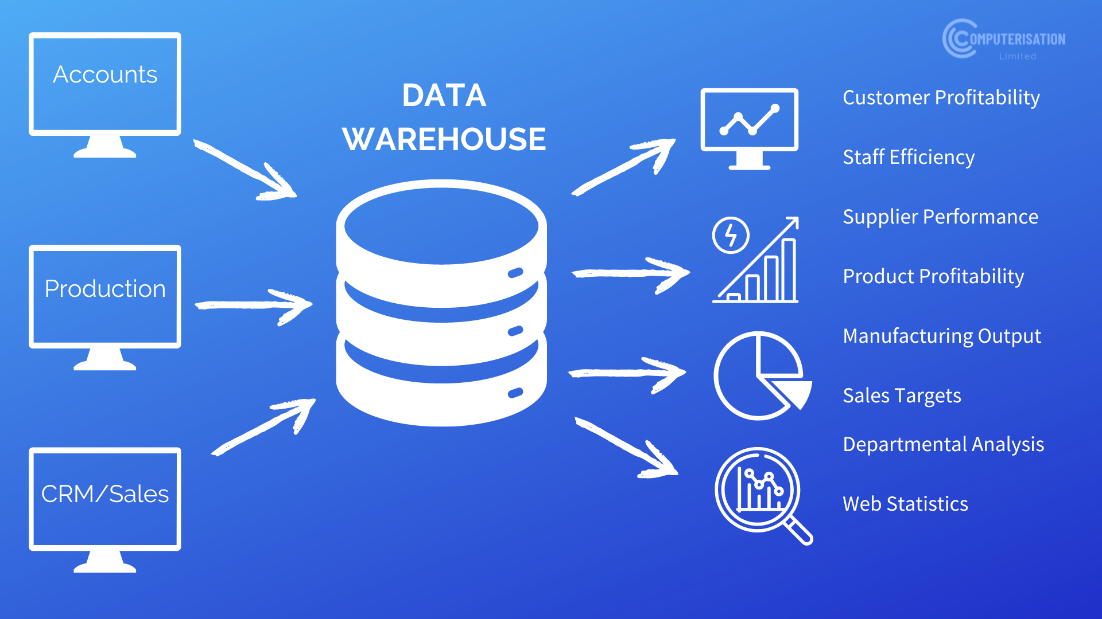
Data Warehousing
The Fundamentals

Slide 2
Do the following Udemy Course
https://deloittedevelopment.udemy.com/course/data-warehouse-fundamentals-for-beginners/learn/lecture/17618900?start=0#overview

Slide 3
Questions?

